Slide 1
Gender Bias Correction in NLP
Razi Khawaja and Layla Shalabi

Slide 2
PROBLEM
STATEMENT
The characteristic ambiguity of natural language makes robust definitions of bias hard to define. Biases can exist in the domains of sex, gender, age, race, ethnicity, and more either independently or at the same time. As such, measuring the outputs of embeddings can have many blind spots. Metrics have not been finalized.

Slide 3
PROJECT OBJECTIVE
The objectives of this project will be programmatically diagnosing gender bias, programmatically identifying gender bias, and then programmatically correcting gender bias in text databases such that downstream tasks have reduced gender bias.

Slide 4
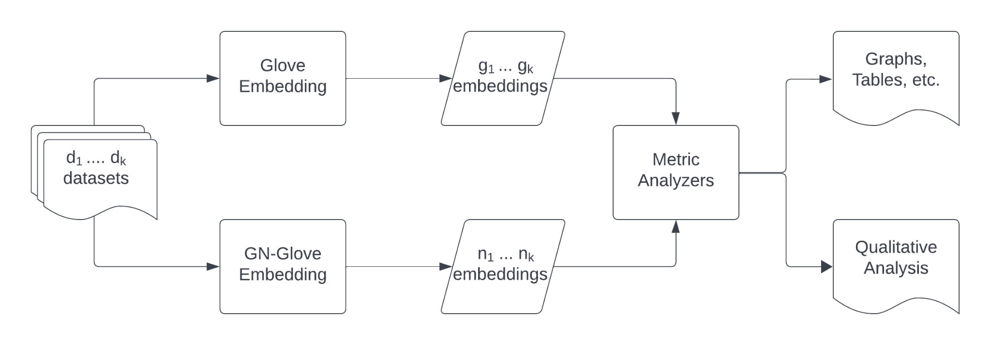
PROOF OF CONCEPT

Slide 5
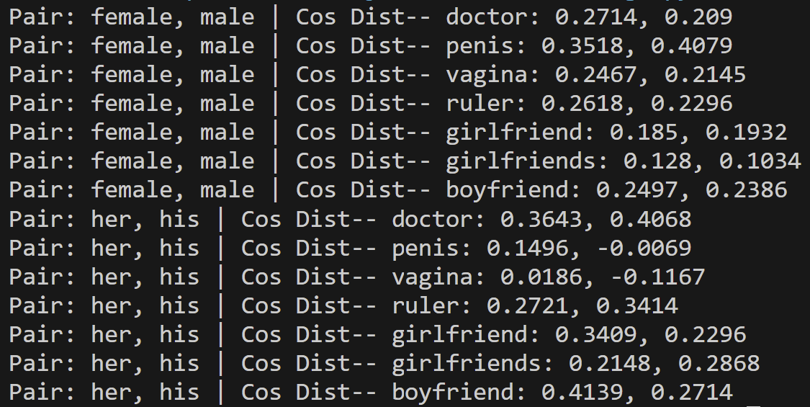
OUR METHOD
Compute embeddings with Glove algorithm on 3 different corpora
Compute embeddings with GN-GloVe algorithm on same 3 different corpora
Our metrics will include:
Euclidean distance between gendered pairs
Cosine similarity between gendered pairs
Other metrics of word bias are also being considered
Qualitative Analysis considerations:
Why hasn’t this solution been implemented already?
Blind spots
Analysis of implementation on what isn’t captured in numbers

Slide 6
Challenges
Implementation obviously not finished
We had many challenges working in an unfamiliar language in C
We had problems with project scope that didn’t get narrowed down until recently
Now that we have access to the data, we still need to decide on appropriate metrics

